Slide 1
HOUSE PRICE PREDICTION
Course : WQD 7005 – Data Mining

Slide 2
Objective
INTERPRET DATA INTO USEFUL INFORMATION
TO MINE THE LISTING PRICE INFORMATION FROM HOMETROVIT DATA IN KUALA LUMPUR
TO ESTIMATE THE SELLING PRICE OF HOUSE BASED ON A SET OF PREDICTOR VARIABLES

Slide 3
VARIABLES USED FOR ANALYSIS
DEPENDENT VARIABLE | INDEPENDENT VARIABLE
PRICE | NO_OF_BEDROOM
 | NO_OF_BATHROOM
 | PROPERTY_SIZE(SQFT)
 | DISTRICT/LOCATION
 | PROPERTY_TYPE

Slide 4
AGENDA
DATA EXTRACTION
DATA PRE-PROCESSING
DATA VISUALISATION
RECOMMENDATION
BAR CHART, STACKED BAR CHART
MODEL COMPARISON
LINEAR REGRESSION ANALYSIS
DECISION TREE ANALYSIS
GRADIENT BOOSTING

Slide 5
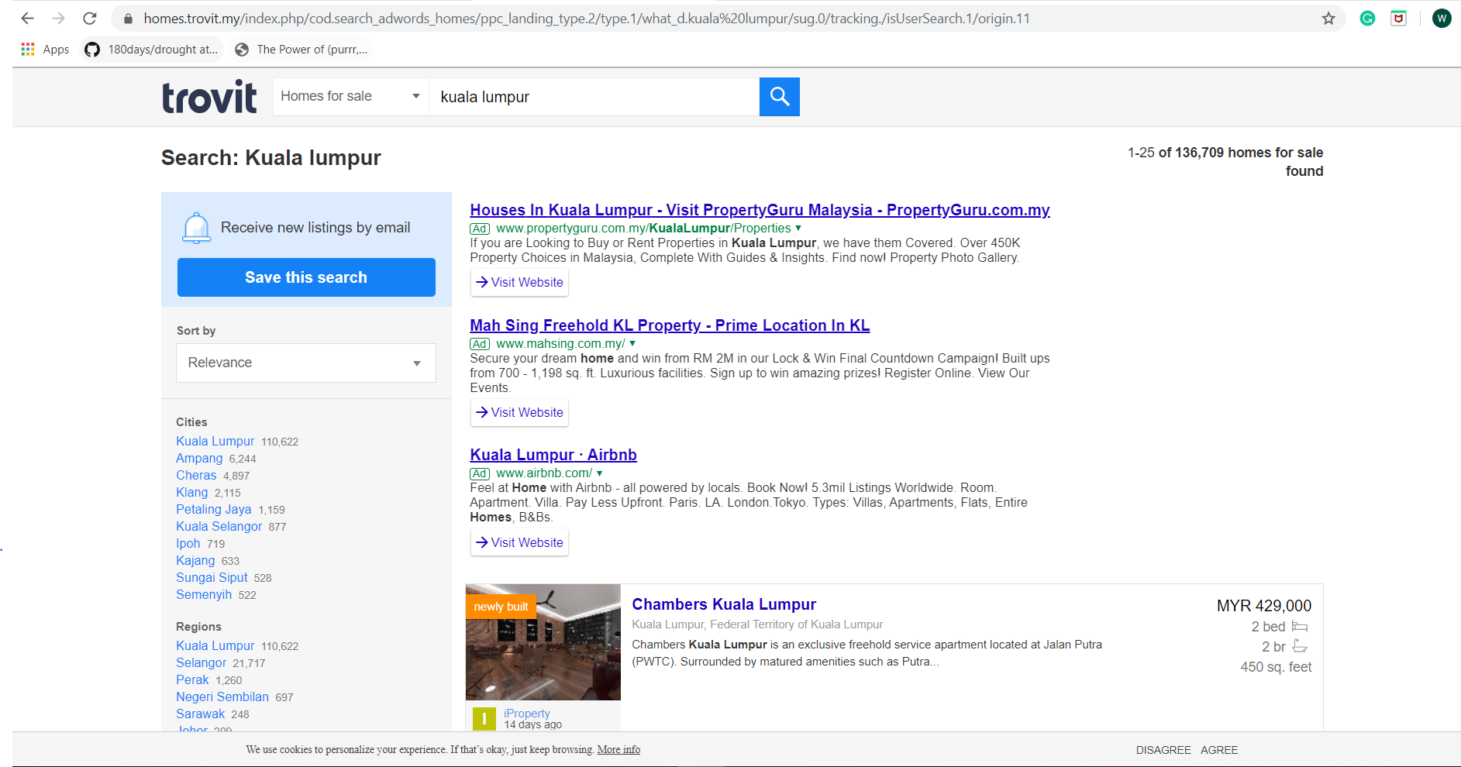
DATA EXTRACTION
https://homes.trovit.my/index.php/cod.search_adwords_homes/ppc_landing_type.2/type.1/what_d.kuala%20lumpur/sug.0/tracking./isUserSearch.1/origin.11

Slide 6
DATA PRE-PROCESSING
REMOVE DUPLICATE DATA
REMOVE NULL DATA
REMOVE THE UNRELEVANT COLUMN(EXAMPLE: URL, IMAGE)
ADDED NEW COLUMN FOR DISTRICT
REPLACE AND IDENTIFY THE DISTRICT AVAILABLE IN THE GIVEN ADDRESS
REMOVE OUTLIERS AND WEIRD OBSERVATION(EXAMPLE SQFT 99999999)

Slide 7
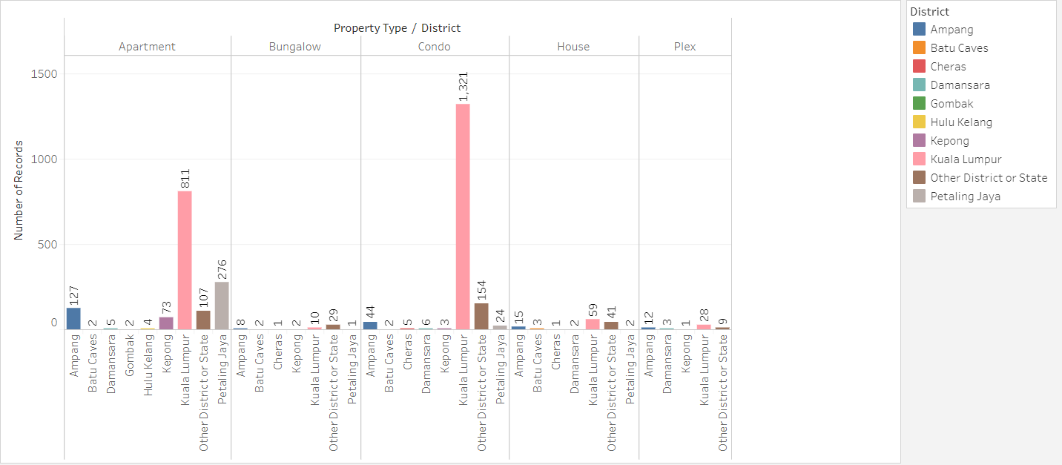
DATA EXPLORATION/VISUALIZATION

Slide 8
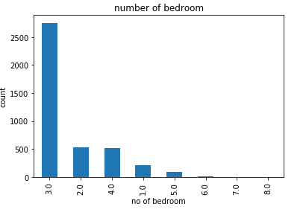
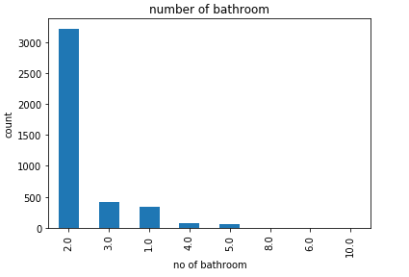

Slide 9
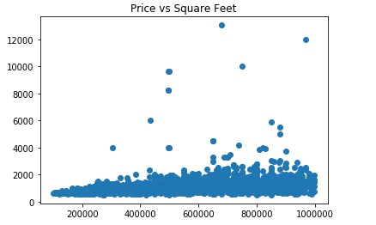

Slide 10
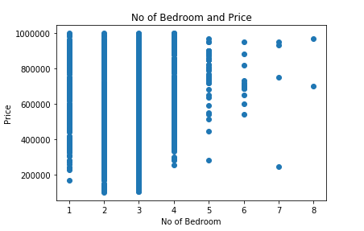
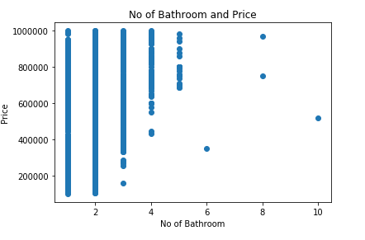

Slide 11
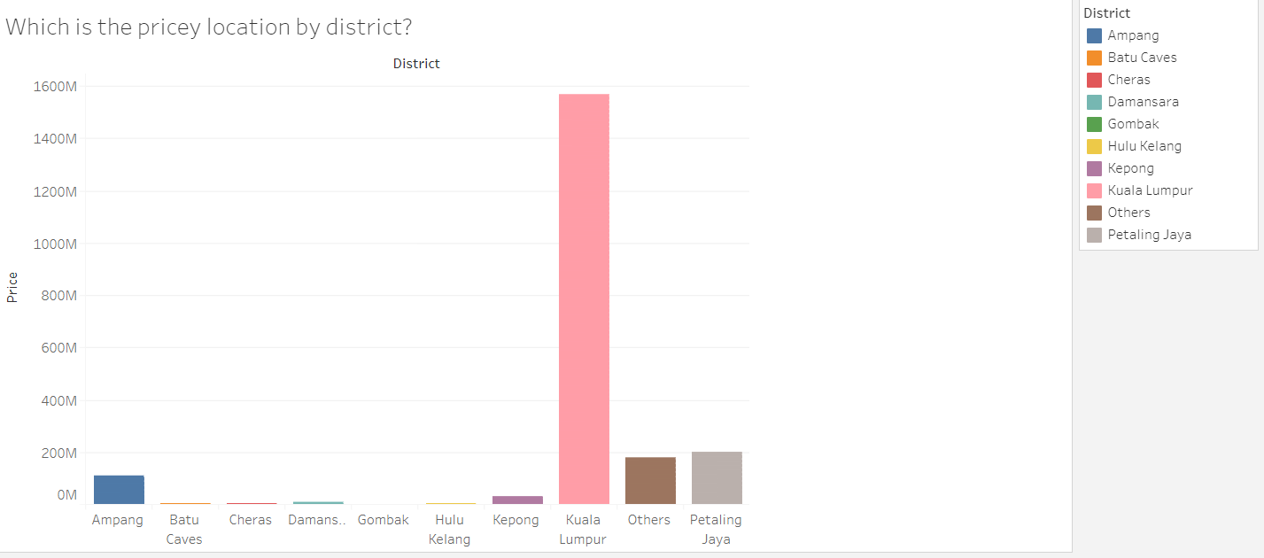

Slide 12
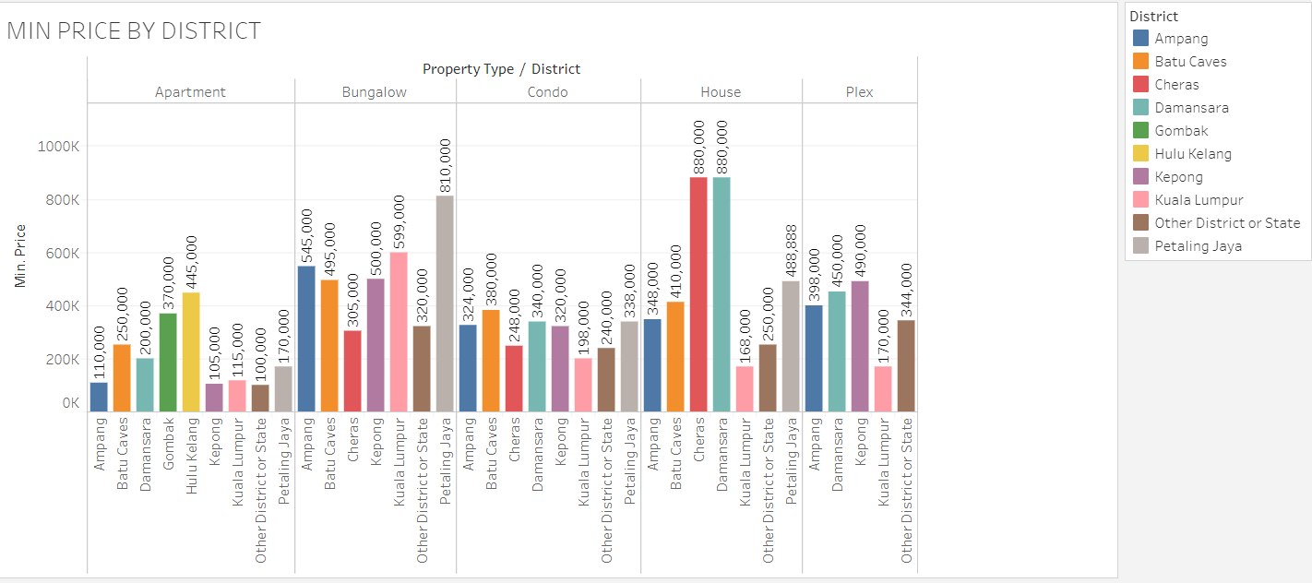

Slide 13
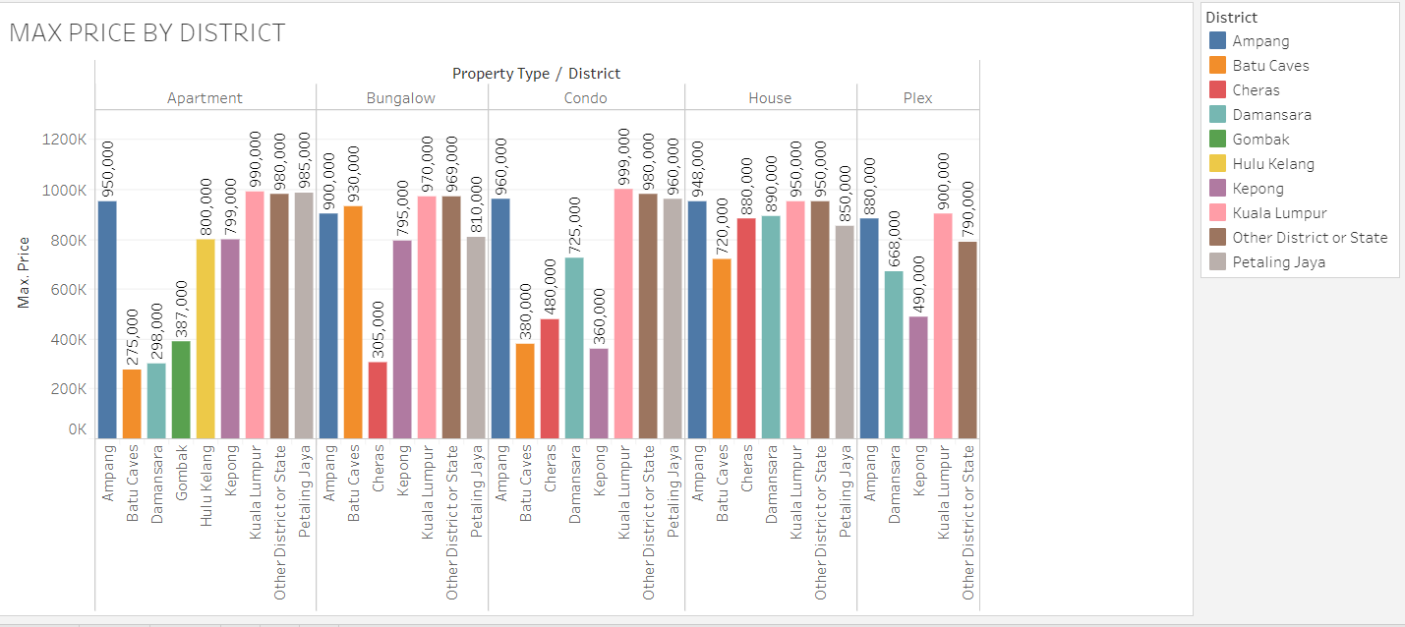

Slide 14
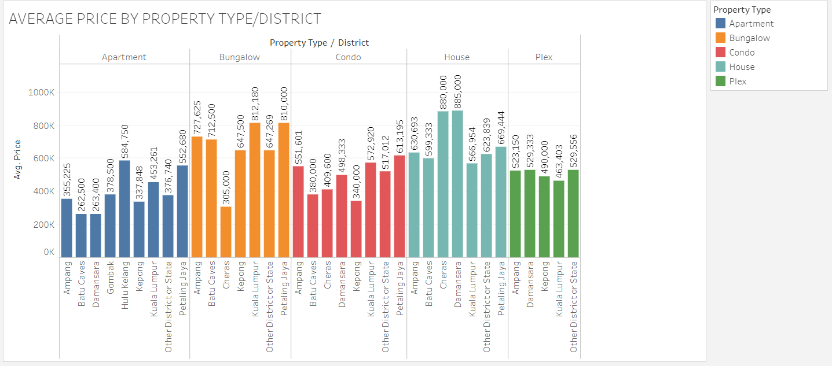

Slide 15
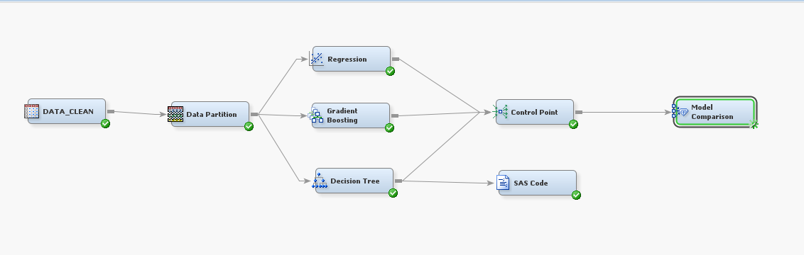
MODEL COMPARISON
Target variable : price
Train = 80%
Validate = 20%

Slide 16
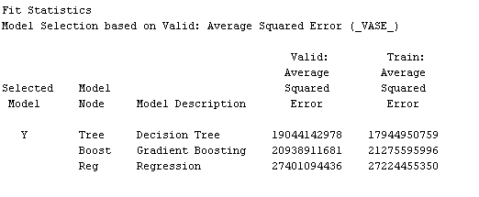
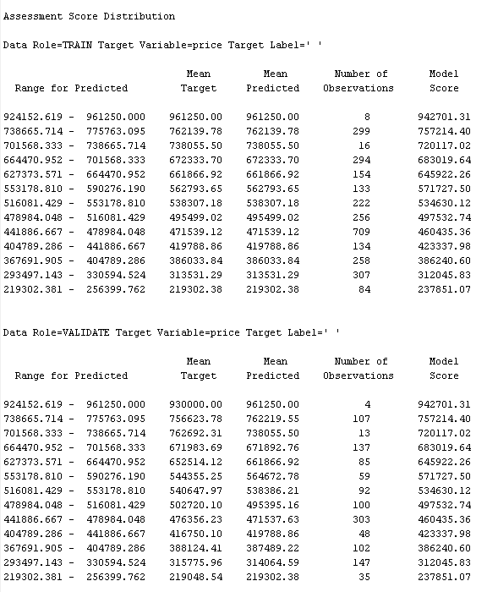
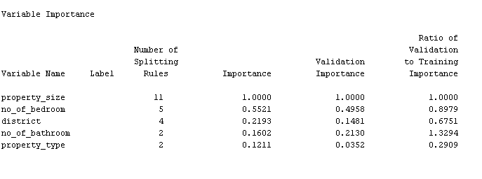
Result : Decision Tree Model is the best model which has the lowest Average Squared Error.

Slide 17
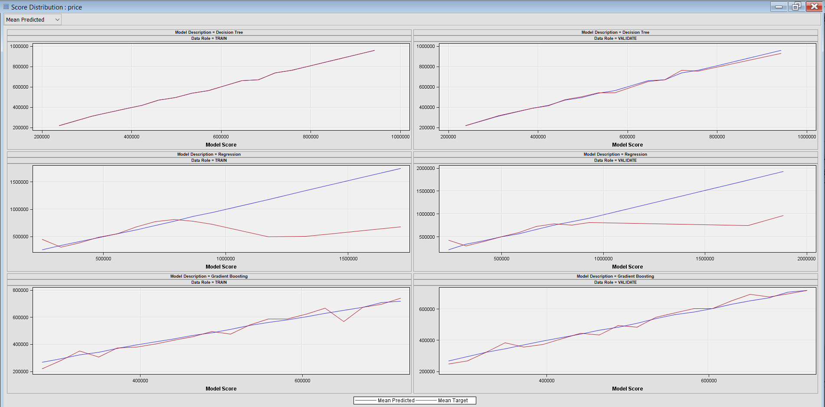

Slide 18
recommendation
provide a more details of the property(example like years of built and other details)

